Slide 1
Welcome to the First-Ever BECoP Social Event!
We are glad you are here
Feel free to start eating

Slide 2
Introductions and Agenda
Eat!
Mad Tea
Surround Sound
Burst My Bubble
Free Form Networking, if time allows

Slide 3
MAD TEA
STEPS:
Number off 1 and 2
Inner and outer circle line up
Answer questions rotating from inner to outer circle
Switch partners at the bell

Slide 4
What was your first job ever?

Slide 5
What do you do for fun?

Slide 6
What was your first role at UC San Diego?

Slide 7
What is a recent success or highlight you experienced?

Slide 8
What is a project you are working on that you enjoy?

Slide 9
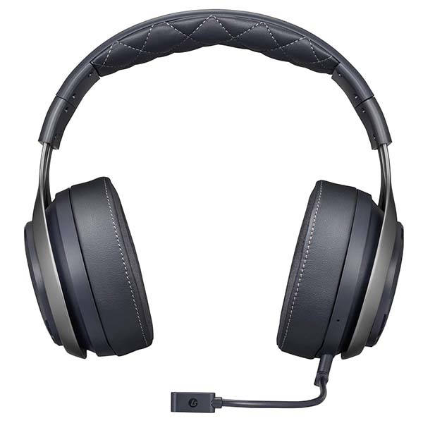
Surround Sound
STEP 1
Alpha sort yourselves by first name.
STEP 2
State your name and role.
STEP 3
Resort yourselves by last name.
STEP 4
Introduce the person to your left.

Slide 10
Burst My Bubble
Get ready to make your choice…and defend it

Slide 11
Burst My Bubble
PC or Mac?

Slide 12
Burst My Bubble
Accuracy or Speed?

Slide 13
Burst My Bubble
Dog or Cat?

Slide 14
Burst My Bubble
Call or Text?

Slide 15
Burst My Bubble
Movie or Book?

Slide 16
Burst My Bubble
Mountains or Beach?

Slide 17
Burst My Bubble
Energy drink or Coffee?

Slide 18
Thank you!

