Slide 2
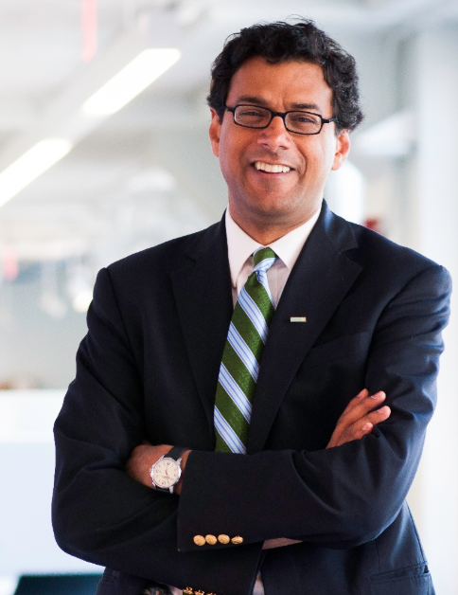
About the Author
He is CEO of the non-profit-seeking health care venture formed by Amazon, Berkshire Hathaway, and JPMorgan Chase.
He practices general and endocrine surgery at Brigham and Women’s Hospital.
He is a professor in the Department of Health Policy and Management and Professor of Surgery at Harvard Medical School.
He is the founding executive director and chairman of Ariadne Labs, a joint center for health systems innovation.
He is chairman of Lifebox, a nonprofit organization making surgery safer globally.
Atul has been a staff writer for The New Yorker magazine since 1998 and has written four New York Times bestsellers.
Atul Gawande

Slide 3
Thesis Statement
Critical tasks are becoming more and more complex and beyond human capacity to store and recall. A simply checklist liberates rather than stifles professional intuition, builds more cohesive teams, and often significantly reduces the error rate of even experienced professionals.
Notes:
Anything I missed or other thoughts?

Slide 4
The Problem of extreme complexity – a few numbers
The doctor’s toolkit
13,000+ recognized diseases
6,000+ drugs
4,000+ medical and surgical procedures
An average doctor, in a year sees:
250 different primary conditions with 900 other active problems
Prescribes 300 different medications
Orders over 100 different lab tests
Performs 40 different office procedures
In complex environments, common failure is the result of:
Fallibility of human memory and attention – especially tasks which are considered mundane and routine
Skipping steps because they don’t always matter…until they do!
Notes:
Atul describes a couple of examples in which vital questions or mistakes were make due to the urgency and stress in the moment.

Slide 5
Dr. Gawande asserts that checklists help to reduce errors when expertise or even “hyper-specialization” is not enough
Question: What are some general checklists that you use in your everyday life?
Question: Why might “simple” be better than “complex”, particularly for experts reluctant to use a checklist?
Notes:
Calendars, SBAR, DMAIC, ADKAR

Slide 6
Not all checklists are created equal…
Question: What are the characteristics of a good vs. bad checklist?
Ineffective Checklists
Effective Checklists
Vague and imprecise
Too long/hard to use
Impractical
Made by desk jockeys without functional knowledge of the field
Try to spell our every step
Turns the brain off
Efficient
To the point
Can be used in the most difficult situations
Practical

Slide 7
Dr. Gawande goes on to describe 3 types of problems
Simple
Basic set of standard instructions that can be followed like a recipe, bring high probability of success.
Complicated
Can be broken down but no set of instructions, success requires multiple people, teams, expertise.
Construction example
Complex
Expertise is valuable but not sufficient, problems tend to be unique. Outcomes highly uncertain.
Hurricane Katrina example
Aviation Examples

Slide 8
Given that most critical work people do is not simple…
Question: What are some examples of critical work that we do and how might a checklist be used to prevent errors?
Question: What did you think about the communications checklist as in the construction example? Is a communications plan the same or sufficient? Why or why not?

Slide 9
Key Decisions for Checklists
Define clear pause points for usage
Decide whether it should be a
“Do-Confirm” vs a “Read-Do” checklist
How many items on the checklist – ideally between 5 and 9 items
Wording and layout – simple and exact, familiar to profession and easy to read
Test in the real world

Slide 10
The Surgery Checklist

Slide 11
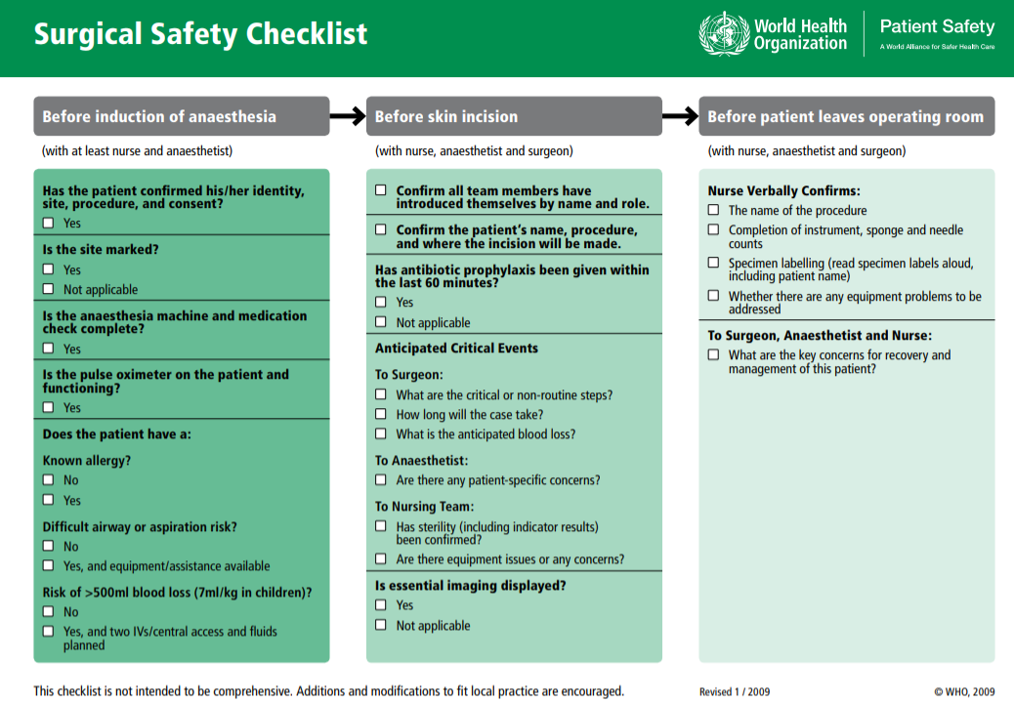

Slide 12
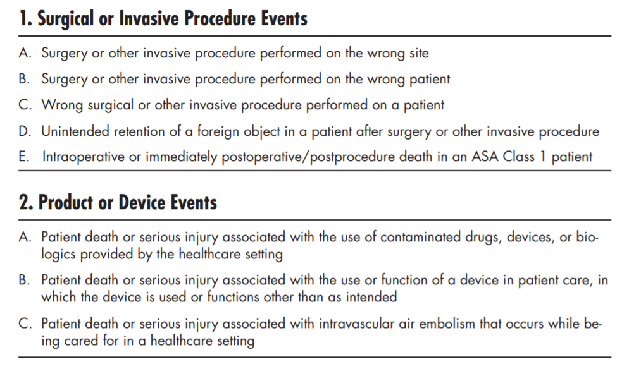
8 out of the 29 “Never Events” or SRE’s (serious reportable events) are related to Surgical Services
Notes:
Initially released in 2002, revised in 2011
Must be reported within 24 hours, investigation must commence within 48 hours, and you will get an unannounced visit from the

Slide 13
Checklists in “your” areas?
Question: How do you think the checklists improves team collaboration? Have any of you experienced a similar affect?

Slide 14
What Other Questions Do You All Have For The Group?

